Slide 1
Christian Aid Myanmar Strategy
( Opportunities for Nexus Programming)
Mani Kumar
Country Director-CA Myanmar makumar@christian-aid.org

Slide 2
CA Myanmar Strategy
Christian Aid has been present in Myanmar over 3 decades with programmes, partnerships and projects focused on Civil Society Strengthening, Humanitarian, Development and Peacebuilding to build community resilience of conflict and climate induced disaster affected people.
Our programmes are driven by Standing Together for Dignity, Equality and Justice
We have successfully provided practical support to more than 25 partners in Myanmar to meet the social and economic needs of the most vulnerable and marginalised; responded to the emergency needs of people and communities displaced by conflict and disasters; addressed the root causes of poverty; and supported the building of local agency/CSOs/community institutions with social cohesion and trust building.
Poverty, power and prophetic voice are the three pillars of our programmes to address and eradicate poverty and sufferings of people from hunger and injustice.
We provide a platform for the triple nexus to do exactly what the nexus should do – support more coherence and coordination between humanitarian, development and peace actors and actions to address intersecting multidimensional inequalities in the places it works.

Slide 3
CA’s offer on Nexus
Our approach is to strengthen coherence and coordination between humanitarian, development and peace actors and actions to address intersecting multidimensional inequalities in the places it works. CA is developing Nexus strategy paper.
Peacebuilding is a key foundation pillar which is strongest part of our work in sustained humanitarian and development projects designed to address emerging nexus needs in fragile context, with thorough conflict analysis with a combination of emergency assistance, community led design and plans, and livelihood and socio-economic needs to build resilience.
We work with local partners and CSOs to deliver transformative emergency assistance that provides life-saving support through community led and localised actions based , addresses the root causes of conflict through mediation, dialogue and peacebuilding, and promote long-term and inclusive economic and social development.
Our focus /aim is to enhance community resilience of conflict affected communities in tackling conflict, reduce risks and have improved access to humanitarian assistance and sustainable development.
Following nexus approach, we build capacity of conflict affected communities/IDPs and related CSOs on participatory vulnerability capacity assessment ( PVCA), conflict analysis and Gender and Power analysis for inclusive nexus plan and programming.

Slide 4
NEXUS APPROACH- HUMANITARIAN- DEVELOPMENT-PEACE
Humanitarian
Saving lives,
dignity,
immediate
assistance, cash transfers, localization, using PVCA tools, safeguarding
and Integrated Conflict Prevention and Resilience (ICPR)
Development
Safety net interventions, Human rights based
approach, GESI,
Sustainable and transformative livelihood support ,Capacity building,
Socio-economic
Empowerment,
and Safeguarding
Peacebuilding
Based on Power and conflict analysis, Social cohesion and dialogue to address Peacebuilding and trust
at the individual and community;
empowerment to
the rights holders; Countering hate-speech
Social Cohesion
+
Conflict Sensitivity
Social Cohesion
+
Conflict Sensitivity
Build Resilient Community

Slide 5
Our change approach
If most vulnerable and marginalized conflict affected and internally displaced people living in camps and communities are equipped with knowledge, capacity, and tools to analyse and plan actions for the risks, shocks, and vulnerabilities they face, then they will be better prepared to respond to emergency crisis and needs, will have improved access to opportunities and services, increased livelihood opportunities and have conflict resolution capacities for peace building.
Helping communities to better manage risks and shocks through developmental interventions and investments are not undermined or destroyed by crises. Because different types of risks (violence and conflict, natural hazards, economic shocks, etc.) and stressors (such as urbanisation and ageing populations) are complex and interlinked, humanitarian and development actors, along with states, must work together more closely to target vulnerability and achieve resilience.
( We are working on nexus approach with support from donors –EU NRM UNOPS with AHCT in Rakhine, Irish Aid In Rakhine and N.Shan, UNWOMEN in Kachin, other supporters and our own funds)

Slide 6
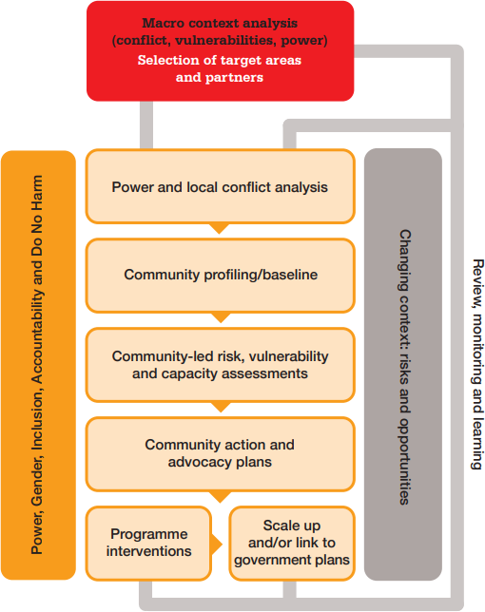
PVCA approach

Slide 7
What opportunities we have?
Given the challenges of access , we would need to focus on community led interventions wherein communities transition in a systematic way from humanitarian assistance into resilience programming based on robust PVCA and Gender and Power analysis in camps and communities.
In our projects that are multi-year, we aim to integrate lifesaving interventions primarily through SCLR ( Survival and Community led Response) and cash grants in first year with village savings and loan associations (VSLAs) and agricultural production interventions. The aim is to move beneficiaries from abject poverty to more reliable livelihoods to stabilise the family units.
With communities, community action plans (CAPs) were developed using the Participatory Vulnerability and Capacity Assessments (PVCA). The CAPs have helped each community to come together to prioritise their needs and potential ways to address them. This helps to support the collective resilience of the community. Also, in places that have low levels of trust or distrust between different groups, it can help to bring them together to agree on needs. Thus, the process supports community level peacebuilding.
Nexus approach can focus more on gender transformative actions by addressing short-term needs of women while at the same time including activities with longer term goals on power relations and justice.
We work with religious leaders to built cohesiveness and trust in communities for humanitarian and development actions.

Slide 8
What opportunities we have?
Myanmar is a complex mix of political, development and human rights crises that is exacerbating and escalating poverty and humanitarian needs that demands nexus programmes.
Continue building and Integrate Conflict Prevention in Humanitarian Resilience Programmes (ICPR) - conflict analysis can help to enhance the conflict sensitivity of resilience programmes
Strengthen Humanitarian and Resilience Projects in Rakhine, Northern Shan and Kachin, focused on - (1) humanitarian interventions; (2a) reduction in GBV; (2b) community peace building; and (3) improved preparedness and responses to risks and shocks, including conflict and violence.
Financing flow analysis to identify gaps, opportunities and mechanisms that strengthen complementarity between H-D-P actors

Slide 9
Challenges
Capacity of local CSO partners on Nexus programming
Financing mechanisms are not incentivizing collaboration and joined-up programming/tied up funds
Integrating and intersecting plans need time and more grounding
Humanitarian needs are acute and hence striking balance is not easy
Limited horizontal & vertical linkages in coordination mechanisms
Lack of conceptual consensus on what a nexus approach involves and what it means in terms of practical programmatic actions
Conducting joint analysis, conflict analysis and planning for reinforcing programming across humanitarian, development and peace actions
Lack of clarity on the comparative advantage of H-D-P actions/ actors

